Slide 1
Skills for a high performing civil service
Public Sector Recruitment: current trends and challenges
Athens, Greece
November 9, 2017
Daniel Gerson, Project Manager, Public Employment and Management
Notes:
Case studies from over 20 countries
SHRM data from all 35 members

Slide 2
Complex multi-dimensional challenges…
The problems that civil services are trying to address are increasingly interdependent and multi-dimensional, within societies which are increasingly pluralistic in views and expectations.
Low Value Conflict
High Value Conflict
High Technical Complexity
Low Technical Complexity
Notes:
The demand for skills: complex multidimension policy challenges: addressing inclusive growth, preparing children to be productive citizens, etc.
In societies which are also increasingly complex: pluralistic – different backgrounds, experiences, understandings – recent political events suggest increasingly divided societies across many different lines.

Slide 3
… technological change and networks citizens…
high
The systems and tools of governance are increasingly digital, open and networked
Outsourced Government
Networked Government
Openness to non-governmental actors
Hierarchical
Government
Joined Up Government
low
Network management capacity
high
Notes:
Supply side issue: new tools – digital technologies – experimental approaches to financing (social finance, social impact bonds) – behaviour insights
Which present new potential, but only in the hands of people with the right skills to use them to drive better citizen outcomes.

Slide 4
… are changing the skills needed in the civil service.
System-wide capacity
Organisational Capabilities
Individual Skills
What is needed are civil servants with skills to address increasingly complex problems in increasingly pluralistic societies using new tools available to governments.
Notes:
What follow is… [read slide] … or at least capable of understanding the potential of these tools…
This report looks at the skills of civil servants and how they’re changing. But it does not try to assume that skilled employee, alone, will make all the difference.
Skilled men and women need to work in organisations that provide the right resources and supports, and these organisations need to exist within systems and it’s the alignment of all of these that creates performance and impact.
I would argue that most of the work of GOV and public administration research in general has focused on the organisational and system-level taking for granted the human talent elements. So this is the beginning of contribution that aims to fill this gap.

Slide 5
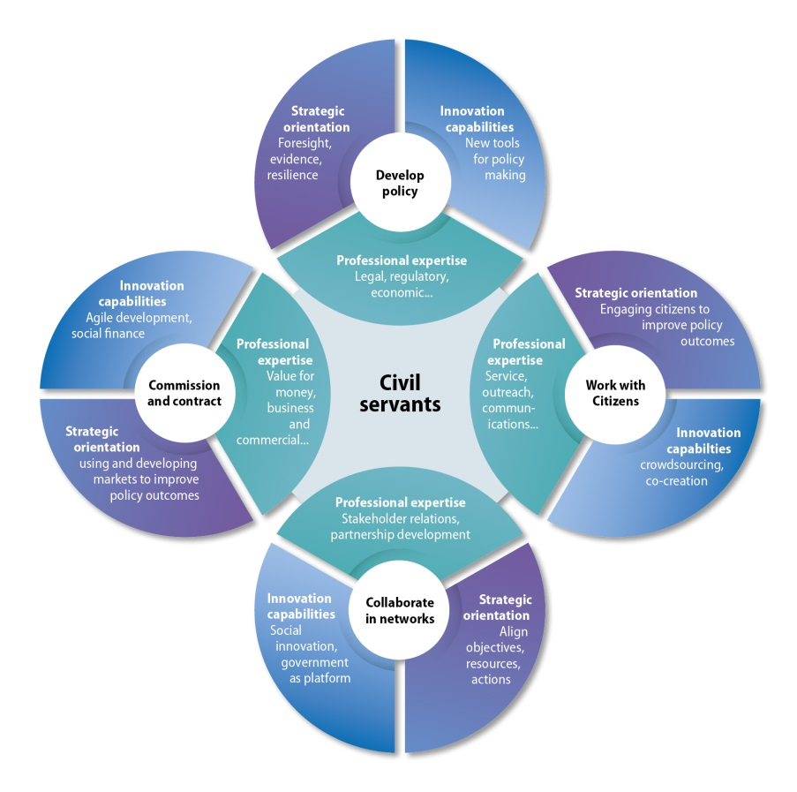
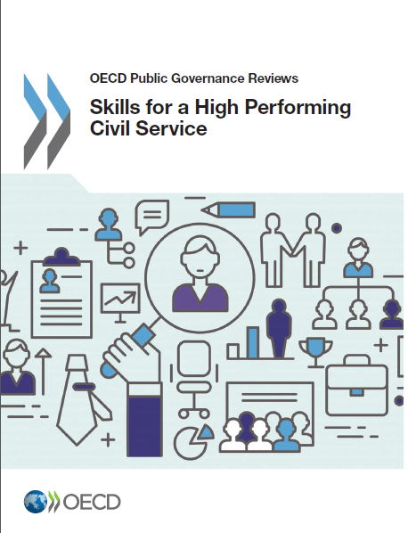
Skills for a high performing civil service

Slide 6
Building a highly-skilled civil service…
1. Determine
What are the needed skill sets and where are the gaps? How can they be identified?
2. Attract and Select
How can the right people with sought-after skill sets be attracted to jobs in the public sector?
3. Develop and nurture
How can public organisations create a culture of learning for a dynamic and fast-changing world?
4. Use
What kind of organisation and leadership to motivate employees and provide opportunities to put skills to use?

Slide 7
Merit Based Recruitment remains a fundamental bedrock of a professional civil service
Source: OECD (2016) SHRM

Slide 8
But are today’s Merit based systems fit-for-purpose in the 21st Century?

Slide 9
Values and behavioural competencies are essential but difficult to assess objectively
Competencies most often highlighted in competency profiles
Source: OECD (2016) SHRM

Slide 10
Some methods (e.g. standard exams) may not be well adapted to new skills needs
Categories that are hard to fill in civil services
Source: OECD (2016) SHRM

Slide 11
The civil service image matters…
Elements highlighted in civil service recruitment material, 2016
Notes:
Although most OECD civil services indicate that they remain relatively attractive employers in the current job market, most face difficulty competing for specific skill sets with the private sector. Understanding what attracts people to careers in the civil service can help to brand the civil service as an employer of choice.
Merit-based recruitment processes have been a bedrock of professional civil services in most OECD countries for many years. However, some may need to update their processes to open up possibilities for recruitment at all levels, quicken the speed of the process and ensure selection is well attuned to future-oriented skills and diversity requirements. Some governments are moving towards competency-based selection processes instead of relying on educational qualifications as the primary indicator or merit.
Another fundamental aspect of attraction and recruitment relates to the terms and conditions of employment. Many civil services use common employment frameworks across various categories of employment. While this reinforces internal equity, there may be benefits in bringing an evidence-based and principled approach to the design of specific employment terms and conditions for specific streams or professions. This can be done to align aspects such as pay and job security with the requirements of the job the employee does and the conditions of the broader labour market.

Slide 12
And increasingly, OECD countries focus on the senior levels
Differences in selection process for senior managers
Source: Preliminary findings of the OECD SHRM survey 2016

Slide 13
SELOR (Belgium): understanding the employee value proposition
SELOR conducts various surveys to determine what matters to current and prospective employees of the federal government:
Competitive wage package
Pleasant working atmosphere
Job security
Interesting job content
Good work-life balance
Notes:
SELOR is the Belgian federal administration’s central recruitment agency which acts on behalf of over 150 employers. It is therefore a major player in employer branding at the federal level.
Since 2000, SELOR has conducted studies to better understand their employer value proposition (EVP), focusing on transversal elements within the federal functions. The annual comprehensive survey measures which building blocks are responsible for the fact that a candidate chooses a certain employer, or why somebody is eager to work for a current employer. The most recent study highlights the following top five factors:
Competitive wage package: SELOR conducts studies on the remuneration of federal civil servants in comparison to the private sector, with an aim to provide competitive wages, or to be aware of the wage difference, which can help inform other elements of the EVP.
Box 2.10. SELOR and employer branding in Belgium (cont.)
Pleasant working atmosphere: SELOR conducts an annual inquiry into employer branding of the federal administration. The answers of federal employees are compared to the answers of those who are not yet a federal employee. The 2016 survey puts pleasant working atmosphere in third place when the question is asked “what attracts one to the job”: 70% or more of those respondents who are already civil servant states this element as vital, compared to 60% of the non-civil servants.
Job security: The public administration is one of the most secure employers in the national labour market. This factor is always rated as highly important to current and future employees.
Interesting job content: The societal relevance of public office is an asset. The 2016 employer branding survey puts this in fourth place when asked “what attracts one to a job”: 60% of civil servant respondents state interesting job content, compared to 70% of those who are not (yet) a civil servant. Candidates want to do something “useful” and to work to support the public interest
Good work-life balance: The public administration scores highly in this respect. Many administrations work accordingly to the NWOW principles (new ways of working – including flexible work times and places). The 2016 employer branding survey puts this in fifth place: 70% of both civil servants in service or those not yet civil servants state this as important.
Source: Information provided by the Belgian Federal Administration.

Slide 14
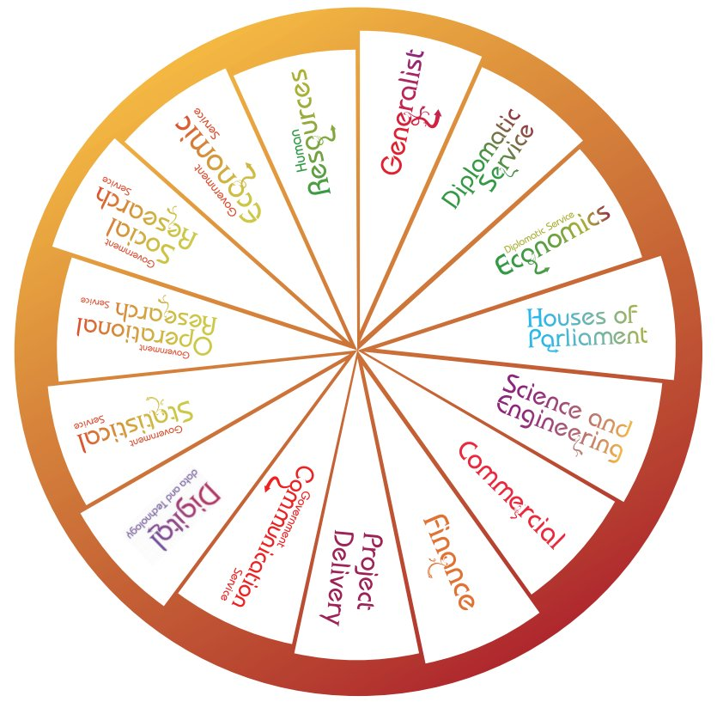
Attracting and selecting the talent needed in the civil service
UK fast stream’s 15 schemes https://www.faststream.gov.uk/
Notes:
Here a number of examples of specific recruitment programmes which seek to identify the best and brightest in certain professions for higher-intensity development and faster progress up the hierarchical ladder.
United Kingdom: The Fast Stream is one of the largest graduate development programmes among OECD countries. In 2015, 21 135 applicants competed for 967 appointments in 15 different specialist and generalist streams. Once selected, the programme equips participants with the knowledge, skills and experience they need to be the future leaders of the civil service. Fast Streamers' personal development is achieved through a programme of carefully managed and contrasting postings, supplemented by formal learning and other support such as coaching, mentoring and action learning. The UK Fast Stream programme promotes diversity and inclusion and produces an annual report with data and analysis showing the range of applicants. This is a good example of data-driven HR analysis. In 2015, a report was produced to understand the factors behind the socio-economic patterning in the Fast Stream and why applicants from lower socio-economic backgrounds are less likely to apply and less likely to succeed. The research provided insight for the wider civil service and evidence to build on and make recommendations to improve socio-economic diversity. The report included recommendations to, among others, introduce a new, enhanced approach to measuring and monitoring socio-economic diversity, establish clearer accountability for socio-economic diversity in the Fast Stream, and introduce enhanced data insights to adjust attraction and recruitment strategies (The Bridge Group, 2016).
The Canadian Recruitment of Policy Leaders (RPL) initiative focuses on recruiting exceptional professionals with diverse achievements and experience into mid and senior-level policy positions across the Government of Canada. Anyone with a post-graduate degree, record of academic excellence or policy experience can apply online during the campaign period. Making it into the pool does not guarantee a placement. However, the RPL has a very successful rate of placement as the candidates are assigned a mentor to guide them through the final stages of the hiring process. Mentors help candidates plan their timeline to begin work, explore options to find the right job, and even arrange meetings with the hiring managers responsible for making an official offer of employment to candidates.
Israel: The Civil Service Cadet Programme intends to build and train a management cadre that will catalyse change in the civil service. Each year, this cadre is identified, screened, and recruited into a six-year training and placement track, after which each cadet is placed in a key position in the civil service. This experience is characterised by an opportunity for the cadets to learn topics theoretically in the classroom, and afterwards be able to observe, experience and acknowledge these topics on the ground accompanied by various methods, such as study visits all over the country and abroad, encounters with people, organisations, perspectives and ideas within the society, simulations, case studies, workshops, and peer learning. After a two-year period, cadets are placed in a government ministry to work in two positions of influence over four years, during which time they build their network and work with other cadets and people in positions of influence, authority and leadership to catalyse change. Currently, cadets are placed in more than 20 ministries and sub governmental organisations on five different content clusters: HRM; social (health, welfare and education); regulations and economy; environment; and governance and macro. For more info see (OECD, 2017).

Slide 15
POLICIES FOR A DIVERSE RECRUITMENT IN THE SENIOR CIVIL SERVICE: THE CASE OF ENA (France)
Merit-based competition whose main aim is to “democratize access to the senior civil service”
BUT the chance to succeed the competition is 1/11 for upper-income class candidate vs 1/43 for a candidate from a lower-income class
Specific preparation class to compensate for the unequal opportunities of lower social class students and to promote diversity in recruitment, to make the Senior Civil Service more efficient and more representative of the population
Photo: ENA
Source: LARAT Fabrice (2015), « Le dernier maillon dans la chaîne des inégalités ? Les particularités du profil des élèves de l’ÉNA », RFAP 2015/1 (N° 153), p. 103-124
Notes:
Photo credits: http://www.ena.fr/var/ena/storage/images/concours-prepas-concours/preparer-reussir-concours/classe-preparatoire-egalite-des-chances/cp-ena/92255-1-fre-FR/CP-ENA.jpg

Slide 16
CONCLUDING THOUGHTS
Building a professional civil service requires fair and open recruitment, built on merit and independence from political influence.
But are yesterday’s merit-based systems keeping pace with the needs of a modern civil service?
Competency based recruitment
Competition for specialist skills
Speed of the process
Diversity and inclusion
To attract and reruit the best, civil service need to adapt their tools, processes and employment offers, based on sound evidence and proactive employer branding strategies.

Slide 17
Thank you
daniel.gerson@oecd.org
oe.cd/pem
@danieljgerson
Daniel Gerson

