Slide 1
Computer-based testing in EU selection procedures Angela Heberling, Head of Unit EPSO
9 November 2017

Slide 2
About EPSO
10 EU Institutions and many EU Agencies
28 EU countries
24 official languages
542,000 applications since 2010
7377 laureates since 2010

Slide 3
"EPSO's role is to serve the EU Institutions by providing high quality, efficient and effective selection procedures that enable them to recruit the right person, for the right job, at the right time."

Slide 4
Testing and Professionalism
A shift from knowledge to competency-based testing
Extensive job analysis undertaken;
- Introduction of Assessment Centres;
- Competency based preselection in 24 languages;
Notes:
4

Slide 5
Some feedback on the procedure
Computer-Based Tests
CBT presents a modern and customer user-friendly image for the EU;
Since 2010, >99% of tests delivered without incident – any candidate who experienced difficulties offered the opportunity to re-test. Candidates able to select time, date and place at which to test;
Candidate surveys show consistently high satisfaction ratings of >90% (on-line satisfaction survey at the end of the tests).
5

Slide 6
A few figures about CBT
> 525,000 exams delivered since 2005
> 365,000 exams delivered under the new selection model (since 2010)
80.000 items (52.000 active in the item bank): one of the largest item banks of its kind in the world
15 different exam set-ups in CBT

Slide 7
Where in competition procedure?
Registration
CBT*
Admission
Assessment centre*
Reserve list
*Depending on the total # of registrations, CBT may also take place at the Assessment Centre stage (AC)

Slide 8
Overview of CBTs in EPSO
Abstract Reasoning
Situational Judgement Tests
CBT
Verbal & Numerical reasoning
(in all 24 EU official languages)
Professional / Linguistic Skills (where appropriate)

Slide 9
Ownerships of CBT
All test items (i.e. questions) used are exclusive property of EPSO, i.e. not of any external entity
On the basis of proposal by EPSO, the Selection Board decides on the content (both ex-ante and ex-post) and on the difficulty level

Slide 10
The main MCQs

Slide 11
Verbal reasoning test
The Verbal reasoning test enables the objective assessment of the candidate's ability to reason and understand information in verbal format. Each question is based on a textual scenario linked to four different answer options, only one of which is correct.

Slide 12
Verbal Reasoning (VR) 1/2

Slide 13
Verbal Reasoning (VR) 2/2

Slide 14
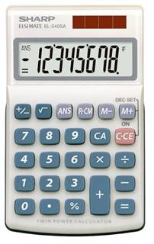
Numerical reasoning test
The Numerical reasoning test enables the objective assessment of the candidate's ability to reason and understand information in numerical format. Each question is based on a numerical scenario (tables, charts, graphs and including textual instructions ) linked to five different answer options, only one of which is correct.

Slide 15
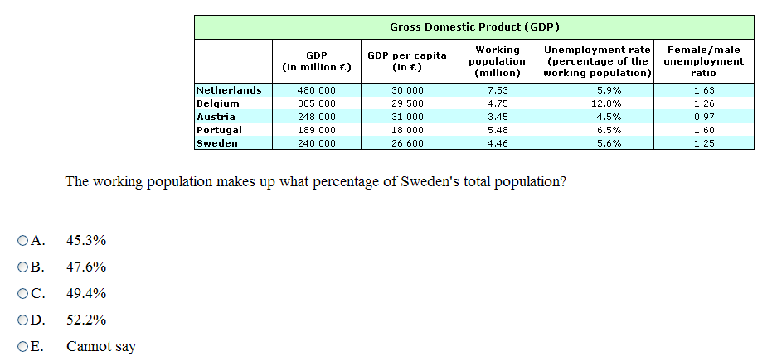
Numerical Reasoning (NR) 1/2

Slide 16
Numerical Reasoning (NR) 2/2

Slide 17
Abstract reasoning test
Detecting and understanding relationships between concepts
Test on ability to think flexibly and solve novel problems (‘fluid intelligence’)
Independent of acquired knowledge
NO spatial reasoning, verbal/numerical concepts
Timeframe per test: 10 items in 10’
Objective, reliable and fair testing tool
Largely unaffected by differences in ethnicity, education, gender and cultural background
A good predictor of future job performance
Very good cost-benefit ratio (e.g. no translation effort)

Slide 18
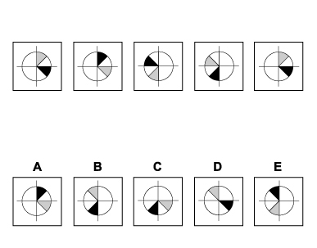
Abstract Reasoning (AR) 1/2
From the options available, please choose which diagram would come next in the series:

Slide 19
Abstract Reasoning (AR) 2/2
From the options available, please choose which diagram would come next in the series:

Slide 20
Situational Judgement Tests (SJT)
candidate is presented with a variety of situations likely to be encountered ‘in the job’
each situation is accompanied by a number of different responses the candidate could apply to the situation
candidate is asked to choose what he/she thinks is the most effective AND least effective response in light of the given scenario
mapped on EPSO’s competency framework
Notes:
20

Slide 21
SJT competencies (from the EPSO competency framework)
Analysing &
Problem solving
Identifies the critical facts in complex issues and develops creative and practical solutions
Delivering Quality &
Results
Takes personal responsibility and initiative for delivering work to a high standard of quality within set procedures
Prioritising& Organising
Prioritises the most important tasks, works flexibly and organises own workload efficiently
Resilience
Remains effective under a heavy workload, handles organisational frustrations positively and adapts to a changing work environment
Working with Others
Works co-operatively with others in teams and across organisational boundaries and respects differences between people

Slide 22
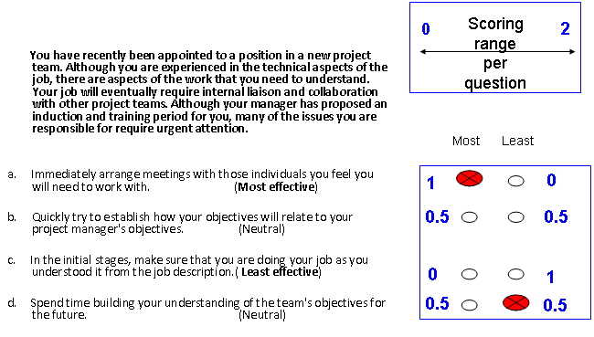
SJT sample item

Slide 23
Language Comprehension Tests
1 text of +/- 1 A4 page linked to 12 Multiple Choice Questions (MCQ) with 4 possible answers including one unequivocally right answer
Created to test translators in L2 and L3 at C1 level, i.e. native speaker equivalent in CEFR.
Texts + questions contain both difficult words and difficult grammar/syntax constructions + questions on style
Test forms exist in 24 languages - all drafted/trialled in the target language (i.e. not translated!)
Development cycle: 2 years per test form (->quality iterations)

Slide 25
What are the main advantages of the CBT system (1)?
More flexibility for candidates
More cost/efficient for EPSO (reusable questions)
Faster procedure for ALL (overlapping events)

Slide 26
What are the main advantages of the CBT system (2)?
Improved image
Well established process
High security
New types of tests

Slide 27
What are the main challenges of the CBT system? (1)
Overcoming stakeholders resistances in the validation process for new test constructs (e.g. SJT in EPSO from 2009-2011) Measure to address this:
perform trials on new tests to be implemented
run familiarisation sessions incl. extensive room for Q&A
Bring in external, independent expertise
Involve test validators (to a certain degree) in the quality management process of implementing new tests
In overall terms: initiate, manage and control a TRUST building process

Slide 28
What are the main challenges of the CBT system? (2)
Increased level of technical complexity in the CBT supply chain, in particular for a variety of multilingual computerised tests delivered on a worldwide basis. In both high-volume and high stakes of testing operations, any small irregularity can unfold significant impacts.
Manage trade-offs between technical possibilities, political reservations, legal constraints and stakeholders expectations.

Slide 29
Fairness and Equality

Slide 30
How to ensure fairness and equality?
Even though candidates within the same competition do not receive the same questions as they test at different dates and time, the level of difficulty of individual tests delivered is identical, as set by the Selection Board at the start of the process, thereby ensuring equal treatment.
Highly standardised testing requirements across all test centres are also part of the CBT framework contract.
The validity and reliability of CBT is now recognised by well-established European Court of Justice case-law and the Court confirmed the compliance of CBT with the principle of equal treatment.

Slide 31
How to ensure confidentiality?
Formal written commitments
Stakeholders: confidentiality notes
Contractors: specific contract clauses
Restricted access to item content (only officials, no temporary staff)
Secure transfer of sensitive data (FTP, USB sticks, encrypted Emails, etc.)

Slide 32
CBT Item bank: professional psychometric testing
all questions provided by specialised companies (in EN)
Translation done by EU internal translators into all EU official languages
rigorous internal quality control
in-depth item performance analysis

Slide 33
Item performance analysis
Outcome:
template for permanent item monitoring
optimal calibration of test items
ensure 100% equal treatment of all groups of candidates

Slide 34
Psychometrics – item analysis sample item profile
Master code of item
unique number
Number of candidates (in %) having chosen reply A,B,C,D or who skipped the item; correct reply in green
Difficulty of the item (on a scale from -3 easiest > + 4 most difficult
Item characteristic curve (ideal in red) and the performance of our item

Slide 35
CBT item bank: internal quality control
all questions provided by specialised companies
Several layers of rigorous internal quality control before delivery
In-depth psychometric analysis (in-house) after each competition based on IRT ("Rasch Model")
Items showing critical behaviour are flagged and investigated (blocked for delivery)

Slide 36
Complaints and
remedial actions

Slide 37
Item specific complaints
1.
Candidates have 10 days after their test appointment to contest the test content
2.
EPSO identifies the item/s in question based on the information provided by candidates
3.
Native speakers/DGT check the items and make a recommendation
4.
SB decides on whether to maintain or neutralise the item queried

Slide 38
Neutralisation – how does it work?
In case of error, SB may decide to neutralise the item for all candidates who have received it
Points intially attributed to that question will be distributed among the remaining questions
No candidate is unfairly penalised! => Inclusive approach
Please note: Under relevant Case Law, the difference in time that cdts. used to answering questions which were neutralised does not constitute unequal treatment between candidates

Slide 39
CBT Test centres
EPSO is working with an external contractor for the delivery of test events via a framework contract.
Depending on the test events, EPSO is offering world-wide testing in addition to several test centres in the Member States.
The contractor is bound by a confidentiality clause in the contract and must comply with strict security measures and test centre set-up requirements.

Slide 40
Main grievances and formal complaints (1)
The tests have nothing to do with the job
The cognitive abilities tests (verbal, numerical and abstract reasoning tests) deployed by EPSO measure key reasoning abilities for all future EU officials. Based on well-established scientific studies, these tests have the highest predictive value of future job performance (compared to purely knowledge-based tests). Other types of tests, to assess situational judgement or specific professional skills (such as reading comprehension test for Linguists), are directly related to the competencies and future tasks required of EU Officials.

Slide 41
Main grievances and formal complaints (2)
CBT entails high costs
Under the Staff Regulations, EPSO has an obligation to test all candidates who submit their application for a selection procedure within a given deadline.
The costs linked to CBT are limited as EPSO pays only for tests actually taken, on a cost per test taker basis. The costs decrease in inverse proportion to the total number of candidates tested, i.e. the more candidates tested the lower the cost.
As questions can be reused for several competitions, the item bank is a valuable return on investment.

Slide 42
THANK YOU!
Please also check our online IBT platform open 24/7
http://europa.eu/epso/apply/sample_test/index_en.htm

